Slide 1
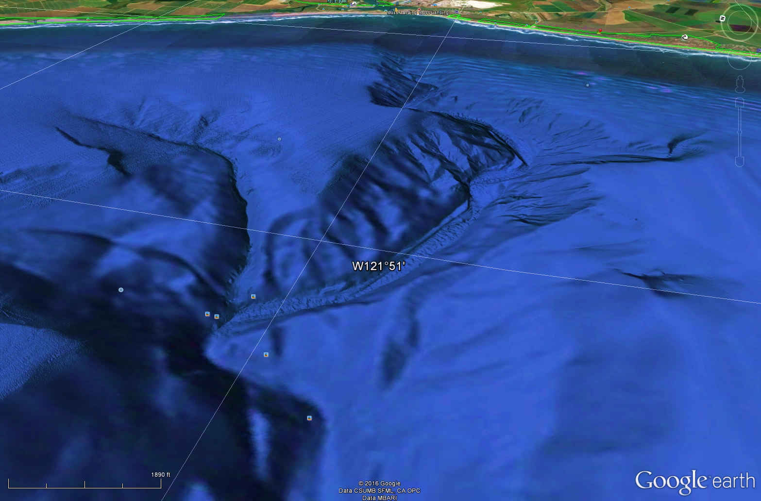
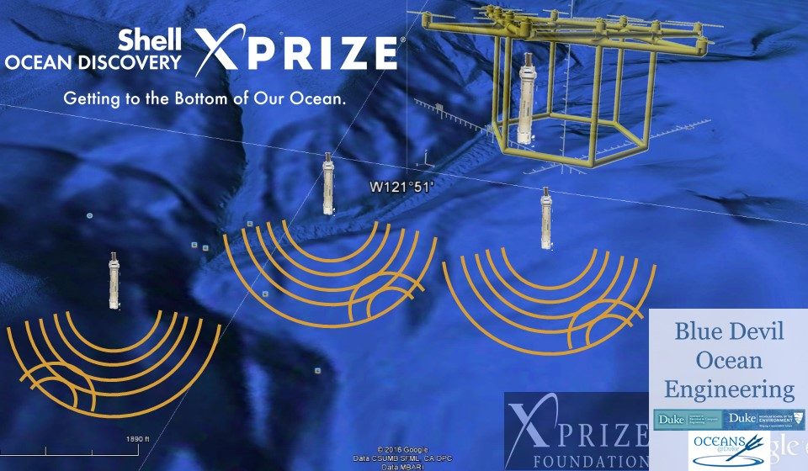
Shell Ocean Discovery XPRIZE Blue Devil Ocean Engineering
http://bit.ly/DukeShODX

Slide 2
The Contest
Prizes
First Place $4M
Second Place $1M
$1M NOAA prize
Other prizes??? TBD
10 teams going to round two each receive $100K
Two (2) rounds over 36 months (3 years)
From the shore remotely produce:
A map of 500 km² of ocean floor (20% in round 1)
Images of biological, archaeological, and geological features of the ocean environment (one at 2000m in round 1 to prove you were there)
$1M NOAA prize data for tracking chemical signal

Slide 3
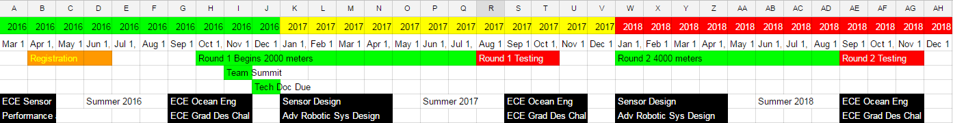
Contest Timeline
Fall 2016, need to submit Technical Document
If proposal is accepted can compete in Round 1
Round 1 = Spring, Summer 2017
Ocean Testing = Summer 2017
Team Summit 13-16 November 2016, San Diego, California, USA.
Work in Foundry / 113 A&B Hudson

Slide 4
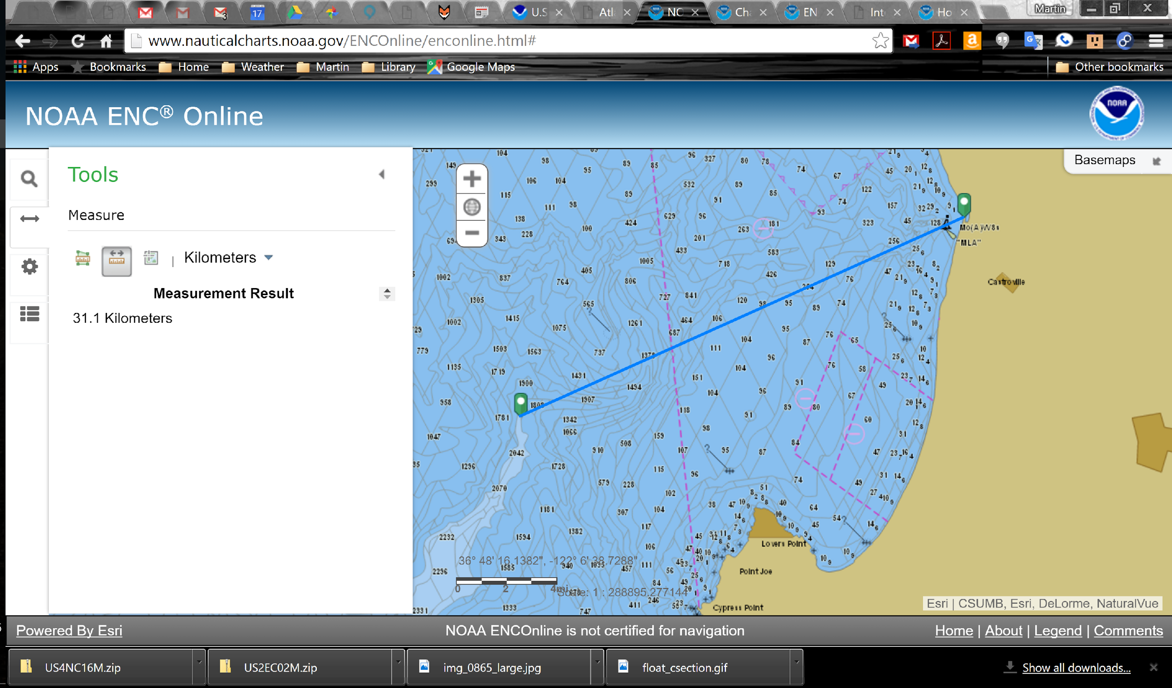
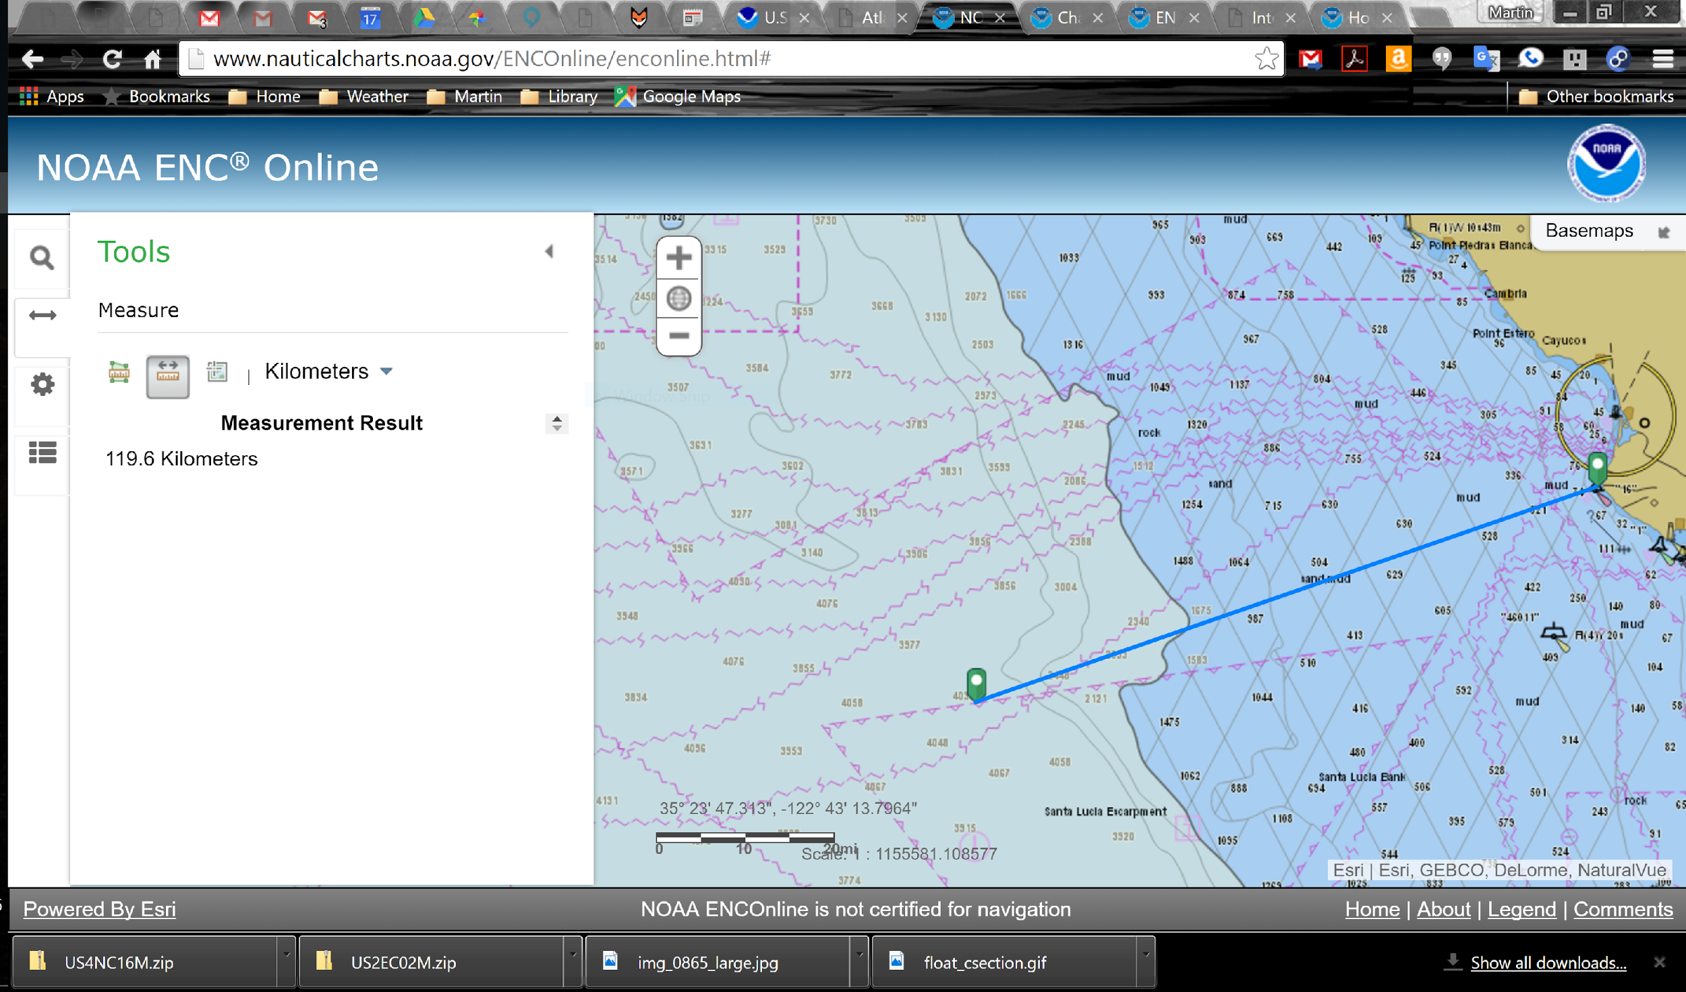
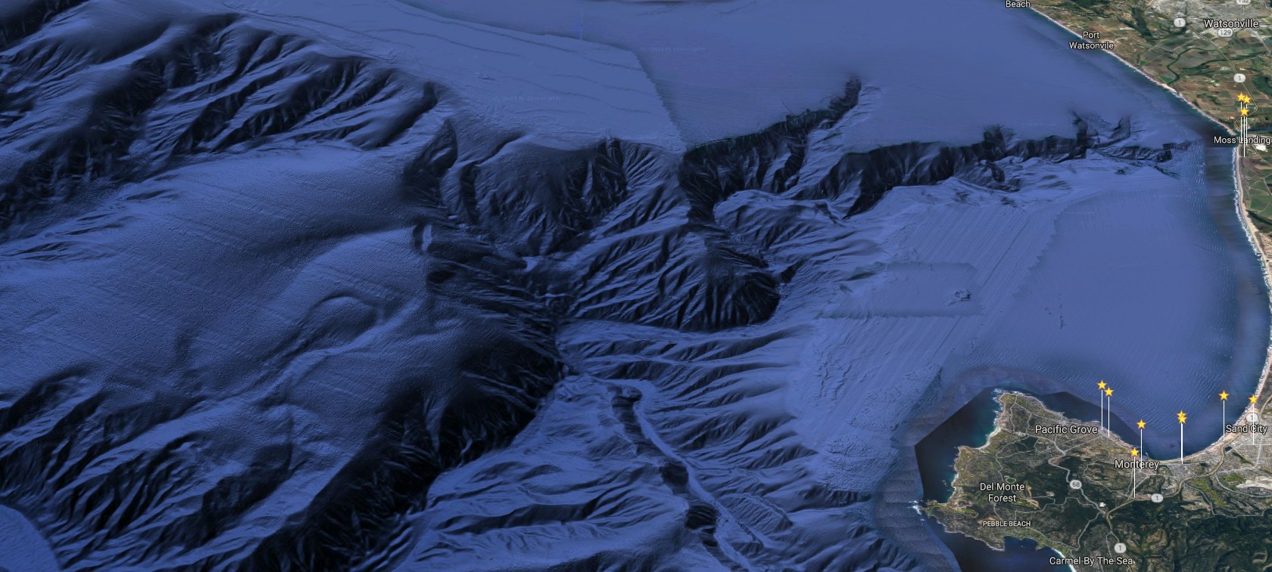
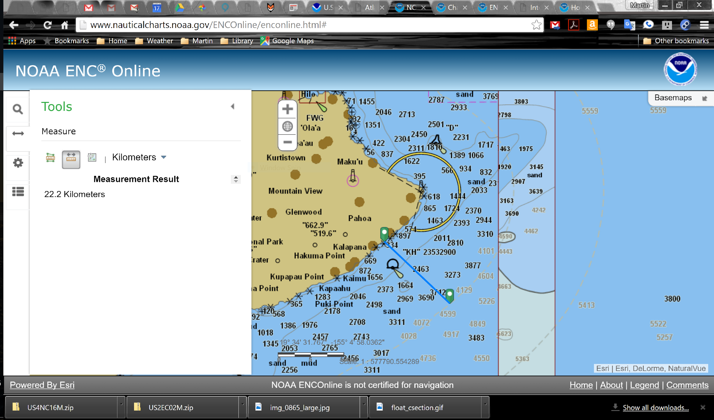
Possible Contest Sites?
Round 1
Monterey
31 km to 2000m
Round 2
Morro Bay
114 km to 4000m
Hawaii Big Island
22 km to 4000m

Slide 5
Our Plan
Synthetic Aperture Sonar Diving Pods
28 kHz Sound system for SONAR
Variable Buoyancy Diving System
IMU + GPS based position sensors
WiFi + LoRa Data communication
Sensor for chemical signature
Heavy Lift Drone
12 Rotors / triply redundant / hybrid gas–electric
Automatic Imaging pod pickup system
WiFi + LoRa Data communication
Offline Location and Mapping
Bathymetric SLAM algorithms
Match models of SONAR to ocean measurements

Slide 6
Six Fall 2016 Projects to choose:
Synthetic Aperture Sonar Diving Pods:
1. 28 kHz Sound system for SONAR (2-3 teams)
2. Variable Buoyancy Diving System (1-2 teams)
3. IMU + GPS based position sensors / WiFi + LoRa Data communication (1-2 teams)
X. Sensor for chemical signature (save for Spring)
Heavy Lift Drone:
4. 12 Rotors / triply redundant (2-3 teams)
5. hybrid gas–electric Power (1-2 teams)
Y. Automatic pod pickup system (save for Spring)
6. Offline Location and Mapping /Bathymetric SLAM algorithms / Match models of SONAR to ocean measurements

Slide 7
Six Fall 2016 Projects to choose:
Projects 1-5 are all Hardware related and use microcontrollers extensively.
Project 6 is software and will probably access Amazon Web Services
I expect to have more than one team on each project, ideally I would like 3 teams on each project, but that will depend on enrollment.
We will conduct a survey early in the class to assemble the teams based on skills / interests / and availability to work together outside of class time.
The grading will be entirely attendance and project performance based.

Slide 8
Things to Do
Compete Surveys to form Groups
Do I have your email?
Arrange for Team photo (per XPRIZE)
Get everybody setup for collaboration
Slack
Sakai?
Google Docs
Box

Slide 9
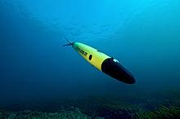
Synthetic Aperture Sonar Diving Pods
28 kHz Sound system for SONAR
192kHz 24bit audio
Sensor Technology SX28-02 transducers
Variable Buoyancy Diving System
Like Seaglider and Argo floats
Cannot use pressure vessel (too heavy)
IMU + GPS based position sensors
9 DOF IMU sensors
pressure depth sensors
WiFi + LoRa Data communication
Sensor for chemical signature
Metal Rods (AKA our XPRIZE sensor)
Colorimetry? ECE 449 Design class

Slide 10
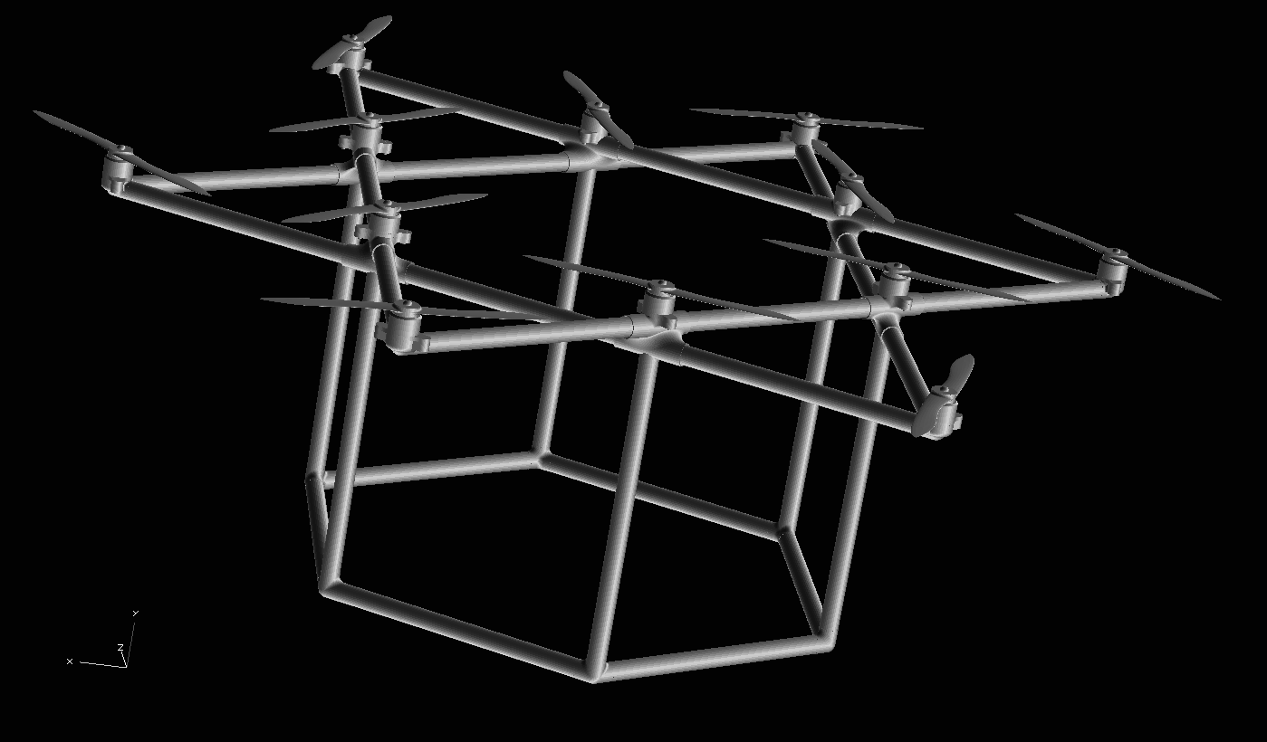
Heavy Lift Drone
12 Rotors / triple redundancy / hybrid gas–electric
Can lift ~10 lbs load with 2/3 power (redundant)
Based on open software Pixhawk
Automatic Imaging pod pickup system
Spring 2017 ECE 496 Robotic Systems Design Topics?
WiFi + LoRa Data communication
WiFi high data rate and close
LoRa long range 15 km??? Under water??

Slide 11
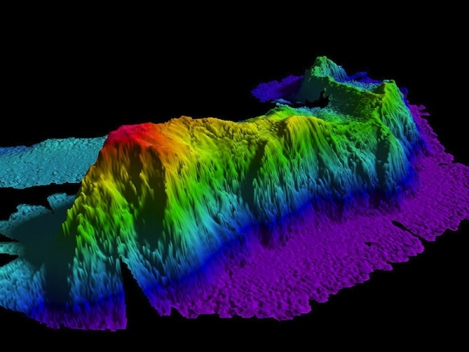
Offline Location and Mapping
Match models to ocean measurements
IMU data / Depth data / SONAR echo data
3D Ocean Map (0.5 meter voxel)
Bathymetric SLAM algorithms
Simulation using ocean acoustics models
KRAKEN: Normal Mode Model
RAM Parabolic Equation
Match Simulation to Measurements
Global Optimization
Error Guided Perturbation Learning?
MATLAB Optimization Toolbox
Amazon Web Services?

Slide 12
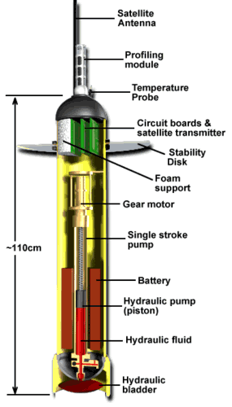
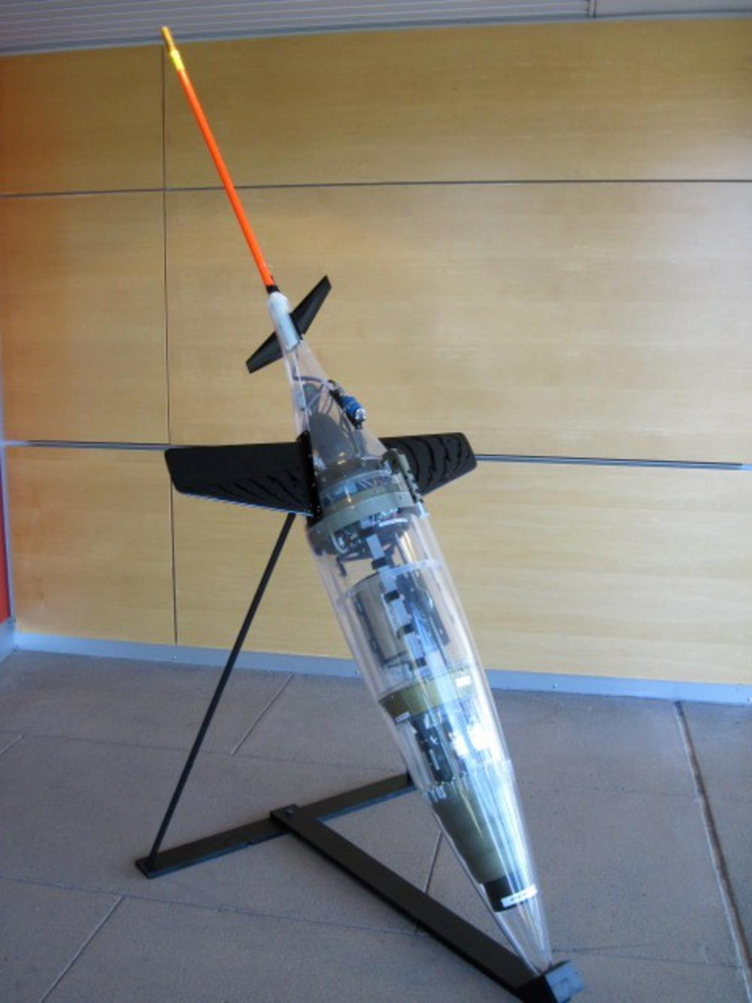
Synthetic Aperture Sonar Diving Pods (SAS Pod)
like Argo pods and Seagliders
Use bladder for dive and ascend
SONAR ping and record as it dives

Slide 13
SAS Pod depths
Round 1 2000m = 20.2 MPa in Seawater
Round 2 4000m = 40.3 MPa
50 MPa is a safe design pressure
~7000 psi ~ 500 Atmospheres

Slide 14
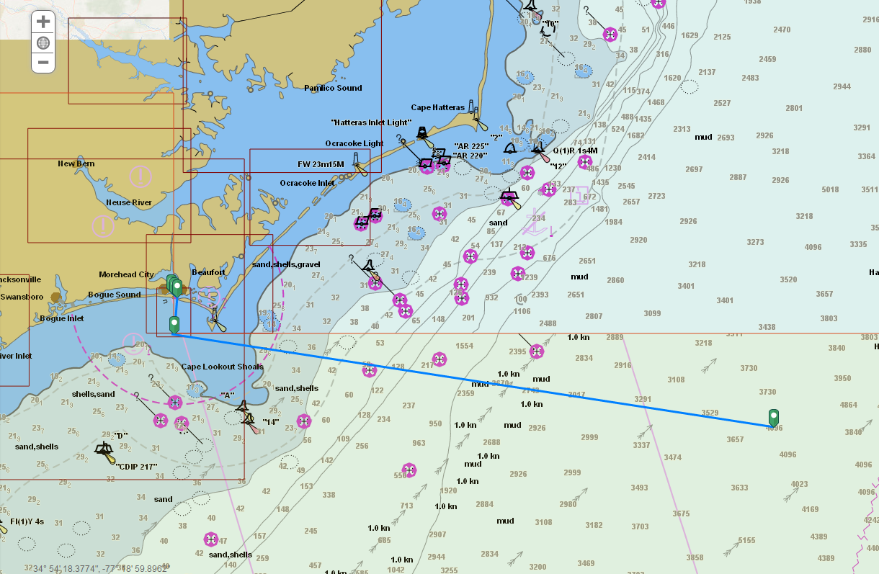
SAS Pod Pressure Testing Facility?
Deepsea / University Labs (PennState?)
Cold Water Pressure washers for test?
Easy-Kleen IS7040G, 7000 PSI
Water Cannon 17H26, 7000 PSI
Pressure Chamber
High Pressure Equipment Company: R6-12-10
$15-30K to set up
Drop them in the ocean!
2000m is 100 km from Duke Marine Lab
4000m is 230 km

Slide 15
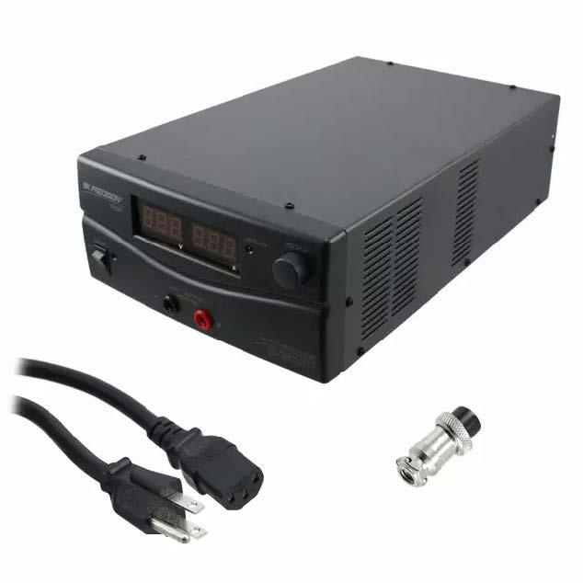
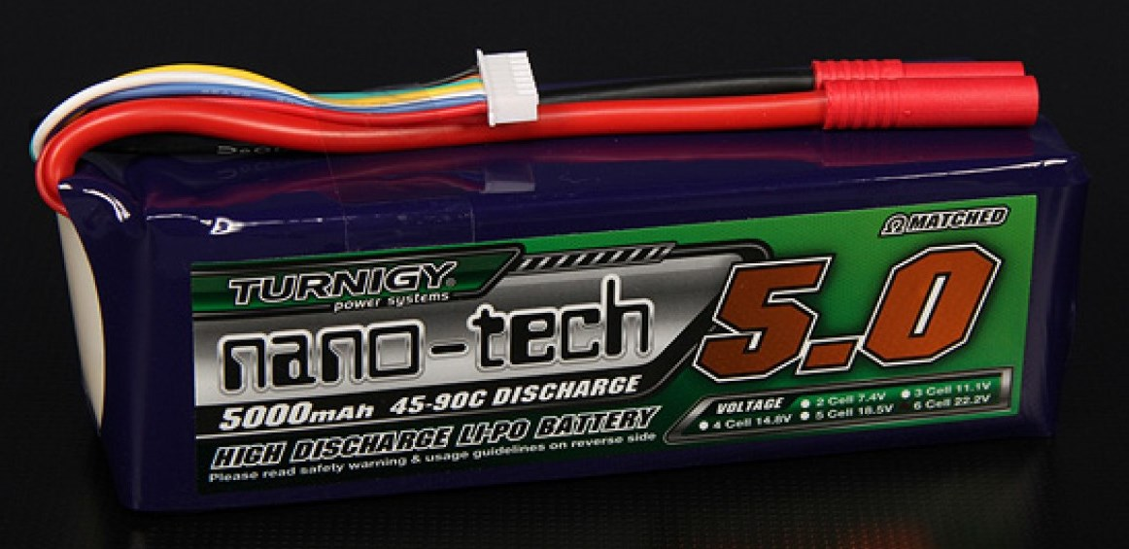
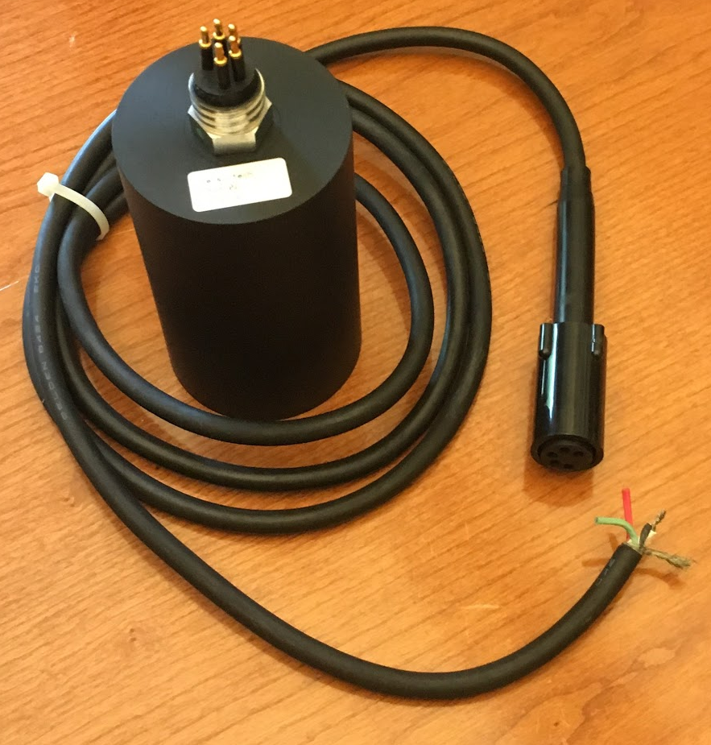
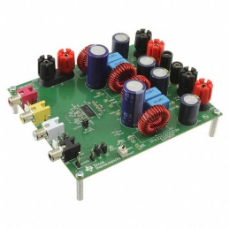
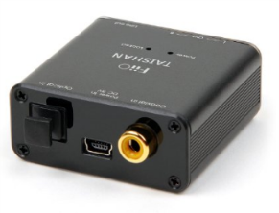
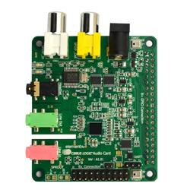
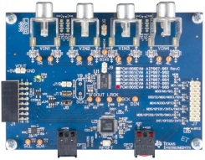
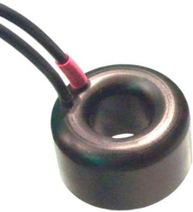
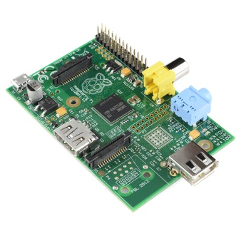
28 kHz Sound system for SONAR
192kHz 24bit audio
OR
Pulses out
Power Supply 1-30V 30A
B&K Precision BK1694-ND
Turnigy nano-tech 5000mah 6S (22.2V) 45~90C (225A) Lipo Pack
Analog audio, beefy
Probably too beefy for our needs, but what I could find
Analog signal-level audio
SPDIF (coax or optical)
Class D Amp Texas Instruments TPA3250D2EVM
(Digikey 296-43809-ND)
Digital-analog converter FiiO D3 (D03K)
(Amazon)
Transducer Sensor Tech Ltd SX28-02 (Sensor Tech Ltd) TVR 173dB@28kHz
Induced audio (level? Needs amplification?)
Should be OK as we have 24 bit ADC?
Need to do the math...
SPDIF (coax or optical)
Raspberry Pi audio card Cirrus Logic Audio Card
(Element14)
OR
Stacked
Analog-digital converter Texas Instruments PCM1864EVM
(Mouser 595-PCM1864EVM)
Echoes back
Transducer Sensor Tech Ltd SX30
(Sensor Tech Ltd) TVR 133dB@30kHz
Raspberry Pi

Slide 16
Sensor Technology SX28-02 and SX30 transducers
Transducer Sensor Tech Ltd SX28-02 TVR 173dB@28kHz
Best Sensor! ($1.2K)
Transducer Sensor Tech Ltd SX30
TVR 133dB@30kHz
Lower Cost ($500)

Slide 17
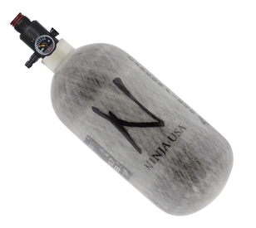
Variable Buoyancy Diving System
Unlike Seaglider and Argo floats we cannot use a pressure vessel (too heavy)
Probably need a gas bladder that inflates as needed to change rate of ascent
We need 7000 psi (3000 psi at 2000m)
Option 1 45 CI 4500 psi Paintball cylinder
OK for round 1?
weight <2 lbs empty
We will probably have trouble with the regulators at depth

Slide 18
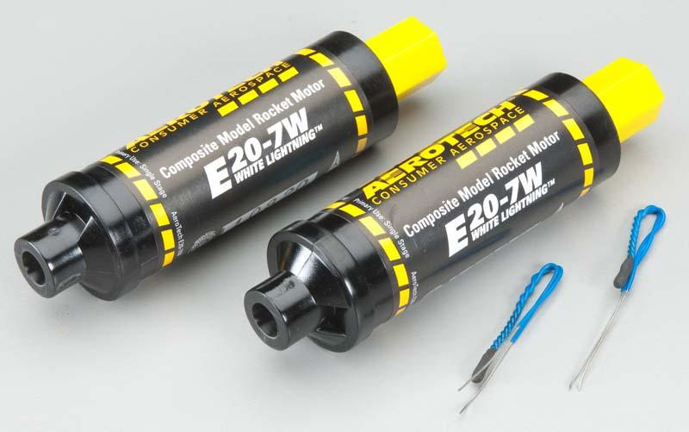
Variable Buoyancy Diving System
Option 2 gas generation from solids/liquids
Hydrogen peroxide
Hydrazine
Chlorates and perchlorates
Sodium azide
Solid rocket propellants - electronic ignition
Ammonium perchlorate composite propellant
E20 $15 35 Ns thrust
G76G $95 Reusable 115 Ns
will these fire at depth?
how much gas? how hot?

Slide 19
IMU + GPS based position sensors
We have Adafruit 10 DOF sensor breakout
L3GD20H / LSM303
AHRS generates Altitude & Heading
Motion tracking need assumptions about motion to remove drift, pressure sensor altitude, average loc. from GPS could work.
BMP180
does -500 m below sea level, >> if in EPOXY?
We have Adafruit Version 3 GPS breakout
MTK3339 only works on surface!

Slide 20
WiFi + LoRa Data communication
SAS Pod use
WiFi high data close range
Used for sending sonar data to drone on pickup
Used for pickup signaling of GPS location
May be used for triangulation for pickup
LoRa long range 15 km??? Under water??
Could allow for better range GPS location signaling to drone for pickup
Communication between pods on surface
Maybe drop LoRa only Pods for communication back to shore for drone?

Slide 21
WiFi + LoRa Data communication
I have a lot of different options for this most of which are meant to be for more general user access.
So you do not have to be a computer engineer or much of a programmer to work on this!

Slide 22
WiFi + LoRa Data communication
LoPy Modules I have:
HopeRF RFM95W 915Mhz models and Dev Sys
LoPy = LoRa version of WiPy (due any day)
WiFi Modules I have:
WiPy
Onion Omega Wifi Microcontroller
based on Qualcomm Atheros AR9331 SOC
Pine64
what is 64 bit good for?
Beaglebone Green
ESP8266
We used this last Fall and Spring semesters
Arduino
Already used for generator and last XPRIZE
Raspberry Pi
Already using for the SONAR

Slide 23
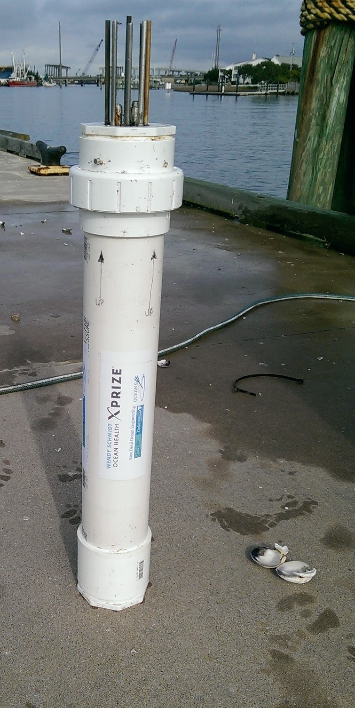
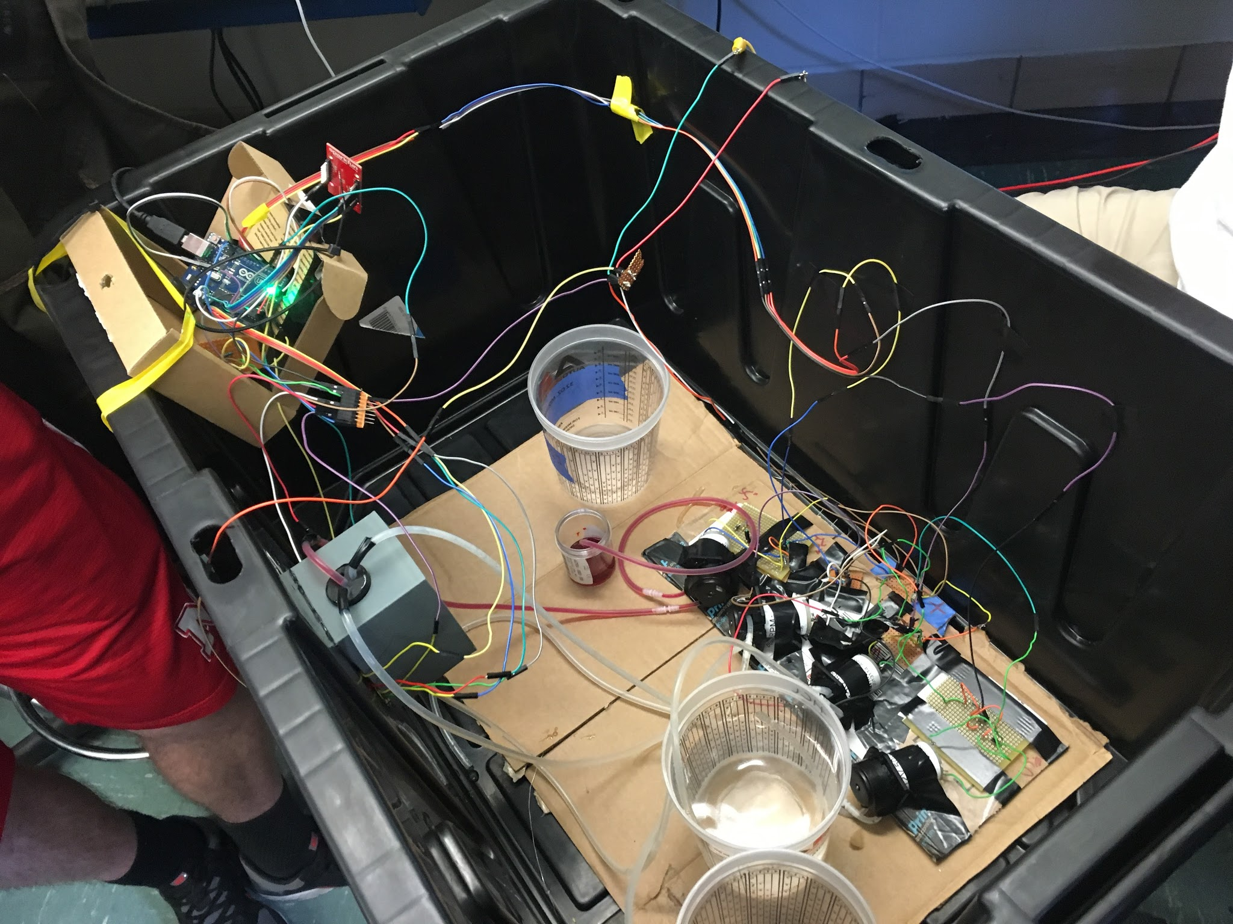
Sensor for chemical signature
Metal Rods? (AKA our XPRIZE sensor)
Colorimetry? Spring 2016 ECE 449 Class

Slide 24
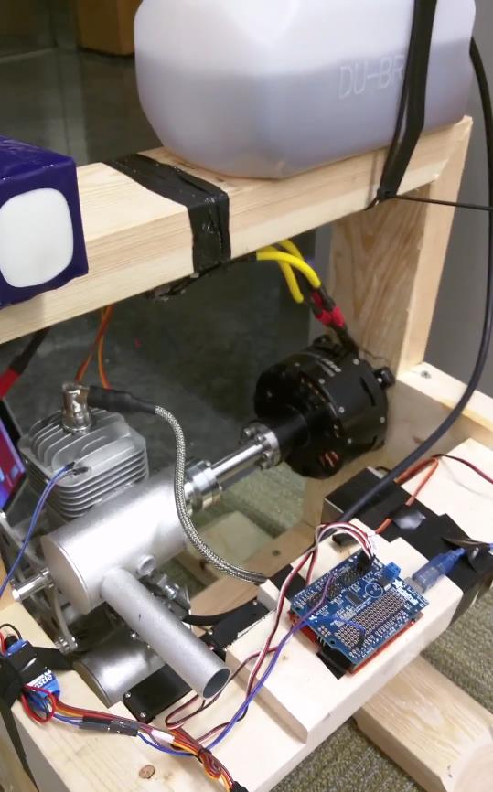
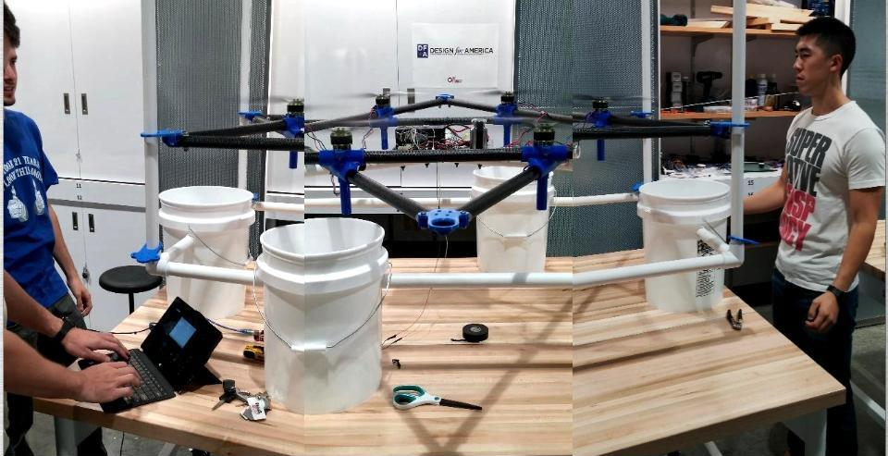
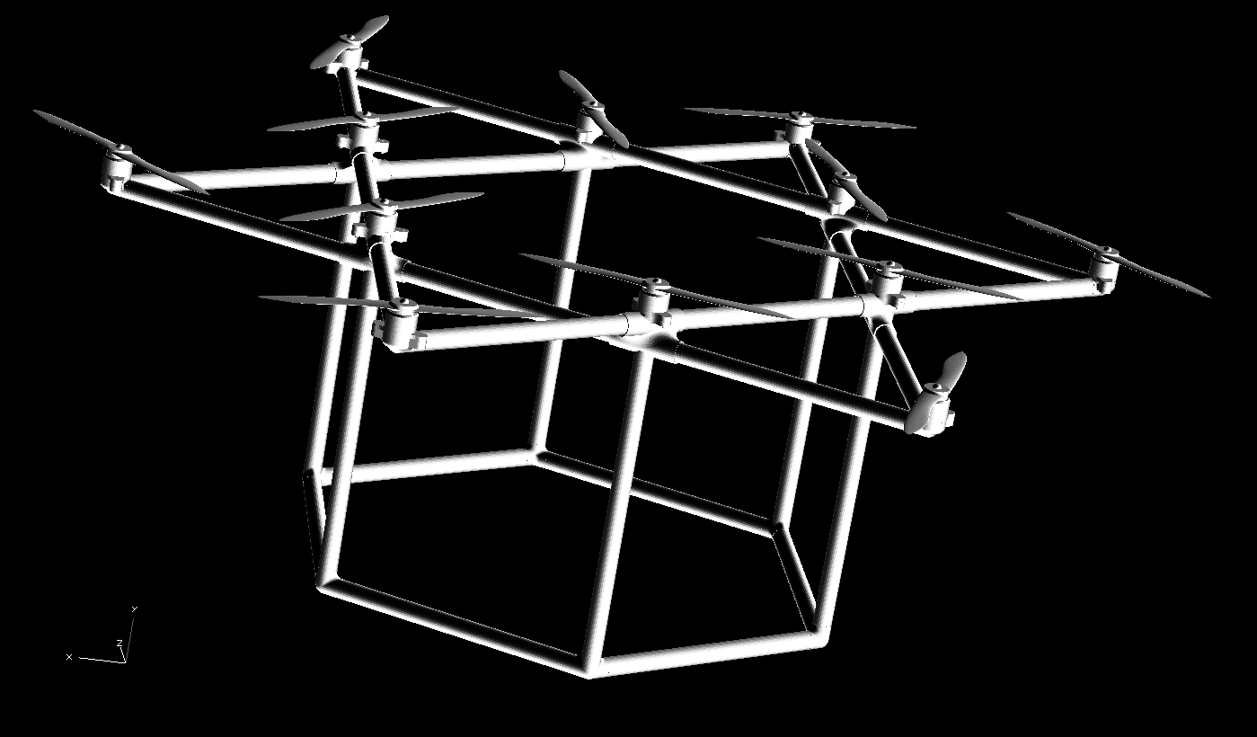
Heavy Lift Drone

Slide 25
12 Rotors / triple redundancy / hybrid gas electric
Can lift ~10 lbs load with 2/3 power
Based on open software Pixhawk
3D printed joints and Carbon fiber rods
Commercial RC drone parts
Needs some work!

Slide 26
Hybrid Gas Electric
Generator Control Documentation.pdf
3 x Generators to Charge Batteries
To enable long range flights
Arduino Control
Needs integration into flight system

Slide 27
Pod Ocean pickup system
ECE 496 Robotic Systems Design Topics?
Need working Drone and Pods first?
Flashing LEDS + Camera for fine location
There are automatic and remote hooks
But we may need ring and grapple pickup?

Slide 28
WiFi + LoRa Data communication
Drone use
WiFi high data close range
Used for sending sonar data to drone on pickup
Used for pickup signaling of GPS location
Maybe used for triangulation for pickup
LoRa long range 15 km??? Under water??
Not sure we will use in the pod
Could allow for better range GPS location signaling
Could communicate back to shore???

Slide 29
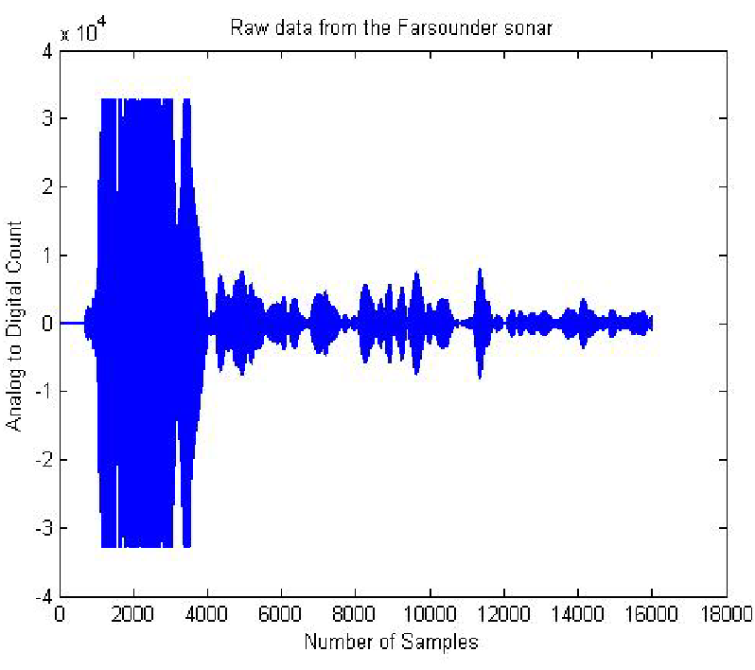
Offline Location and Mapping
Getting from SONAR to 3D Maps
Want 0.5 meter voxel, Very Hard!
Use Matlab + AI + Amazon Web Services

Slide 30
Match models to measurements
Simulate dive and ascent path of pod
Make best guess at path using IMU / GPS / depth data
Simulate SONAR with ocean acoustics models
KRAKEN: Normal Mode Model
RAM Parabolic Equation
use best available maps
Assume that when the simulation matches the measurement the map is correct
Refine map and path of pod to improve match
This is very hard!

Slide 31
Global Optimization
MATLAB Optimization Toolbox
Error Guided Perturbation Learning?
Amazon Web Services?
I imagine us spinning up many parallel AMS servers to generate the map from our data in the 48 hours provided by the XPRIZE

